Slide 1
The Centre County UNITED Way

Slide 3
CENTRE COUNTY UNITED WAY:
501(c)3 non-profit organization
A member of the United Way Worldwide Network – a resource for an identifiable brand, advocacy, training and marketing materials – not a governing body
Managed and governed by a local Board of Directors
Volunteer driven
Focused on improving access to education, financial stability and health for Centre County residents
Partnered with 35 local health & human service agencies who provide direct services to our county residents
Dedicated to raising funds for partner agency programs so agency staff can do the hands-on work they are trained to do
Committed to building collaborative responses to community needs

Slide 4
OUR PARTNER AGENCIES
Centre County United Way donations fund programs – not the agency that provides the program.
All of the funded programs focus on the building blocks of a quality life.
EDUCATION
FINANCIAL STABILITY
HEALTH

Slide 5
“Our partnership with the Penns Valley Area Jr / Sr High School in helping all students get library cards and teaching them how to use our downloadable ebooks and audio has enabled several students who struggle with reading the required literature to access the audiobooks on their school computers. This has allowed them to read the book along with the audio enhancing both reading and comprehension skills.”
Centre County Library, Centre Hall Area Branch

Slide 6
THE PROGRAMS that focus on EDUCATION:
Girls Scouts, Cub Scouts, Boy Scouts,
Venture/Explorer Program, Camping, Outdoor Education
Mediation, Pretrial Release, Youth Aid Panel
Bookmobile, Bellefonte, Centre Hall & Holt Libraries
Big Brothers Big Sisters, Jeans for Teens,
Bellefonte & Mountaintop Youth Centers
Project Restore @ CentrePeace
Child Care Education Safety Net
Literacy Programs, Blueprints for Success
Park Forest Preschool
School Preparedness and Success, Adult Literacy, After-School and Mentoring Programs, Leadership Opportunities, Career Exploration

Slide 7
19% Poverty Rate in Centre Co. – 4th in the state
Mike is currently in temporary housing and needs to take the steps to move to permanent housing. He is employed full time, but spends a lot of his income on his daughter who lives with her grandparents.
We worked with Mike to identify financial goals and develop a budget.
Mike found a very nice duplex that is affordable and is paying close attention to his budget, saving where he can, and making good use of shopping discounts where he works as well.
Mike is doing all the right things and is on the road to financial stability.
- Interfaith Human Services, Financial Care Program

Slide 8
THE PROGRAMS that focus on FINANCIAL STABILITY
Mentor Training, Rental Assistance, Case Management
Emergency Financial Assistance Program
Child Access Center, Domestic Abuse Hotline
Basic Need Case Management, Hotline
Food Bank
Homeless Shelter, Continuum of Housing Services
Financial Care Program, Free Furniture Program, Centre County Fuel Bank
Local Financial Assistance, Transient Assistance
Legal Services and Shelter Program
Affordable Home Ownership & Financial Literacy Services
Breaking the cycle of poverty, Increasing Self-Sufficiency, Creating Financial and Legal Literacy

Slide 9
11% of Centre County residents are uninsured
Adam was diagnosed with bladder cancer. He had no family outside the walls of The House of Care. His family became those who had passed through our doors. Staff, volunteers, home health nurses, emergency response personnel, and anyone else who had provided personal care to Adam, became his family. We went to the funeral home to identify his body and collect his ashes. We notified the appropriate legal entities to stop his government checks and close his accounts. We wrote his obituary, and on a quiet evening we gathered in our living room and held a memorial service of celebration to honor the unique memory of our friend. He came through our door, and we cared and changed together.
The House of Care

Slide 10
THE PROGRAMS that focus on HEALTH
Blood Donations, Emergency Services
Residential, In Home, CARES, Nittany Employment
Special Programs for Nursing Home Residents
Maternal Child Health
Dental Program
Child Development Center
Subsidies for Personal Home Care Assisted Living
Accessible Arts, Education & Outreach, Information & Referral for the Visually Impaired
Employment Services for the Disabled
Early Childhood Consulting, Mental Health Programs, Peer Support
Grief Support Program
Aquatics, Child Care, Summer Camp, Open Doors Financial Assistance
Access to health-related treatment and services, Maternal Health and Infant well-being, Screening, Prevention, Intervention and Education

Slide 11
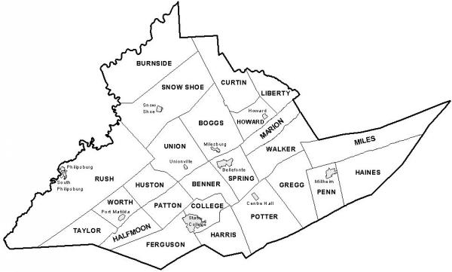
WHY GIVE TO UNITED WAY?
Because the United Way process allows us to GUARANTEE
WHERE YOUR DONATION IS GOING
and to prove the direct impact it is having in
CENTRE COUNTY.
It is not going to an agency to spend as they wish.

Slide 12
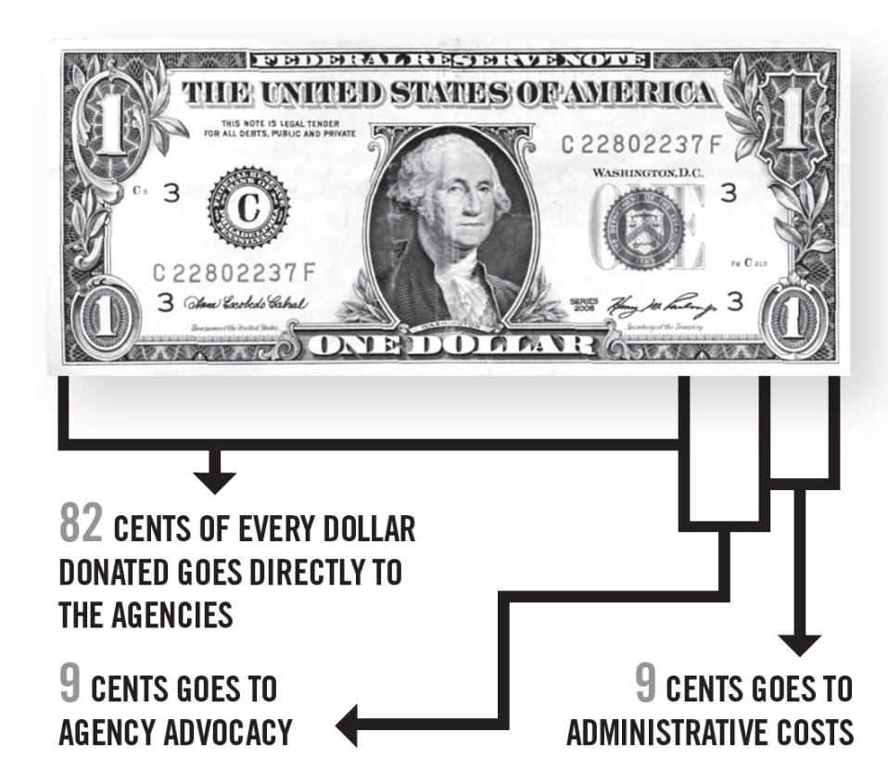
WHAT REALLY HAPPENS TO THE MONEY YOU DONATE?
We all know it takes money to raise money. Centre County United Way utilizes a large volunteer base to raise awareness and financial support of our partner agencies.
A staff of 5 manages the day-to-day operations and support the volunteers.

Slide 13
WHO MAKES THE DECISIONS?
VOLUNTEERS
raise the money and
VOLUNTEERS
determine how much each
program receives through the
FUNDS DISTRIBUTION PROCESS.
Volunteers are recruited to serve as Community Representatives who visit the agencies to review
program services, outcomes and financial management
of United Way Donated Dollars.

Slide 14
Centre County United Way
FUNDS DISTRIBUTION PROCESS
Funding applications are received from partner agencies and reviewed by CCUW staff.
Programs receive funding!
Community Volunteers are trained and placed on panels of 4-6 people who visit 2-3 agencies.
Panels attend agency site visits to review programs and services, budgets and outcomes.
Panel chairs meet to prepare a final recommendation report to be submitted to the Board of Directors for approval.
Panels submit a funding recommendation for each agency.

Slide 15
WHAT’S IN IT FOR YOU?
A stronger, healthier community
A local approach to addressing our community’s needs
A productive work force for the future
A guaranteed return on your investment - with measurable and lasting results
A meaningful way to give back AND pay it forward

Slide 16
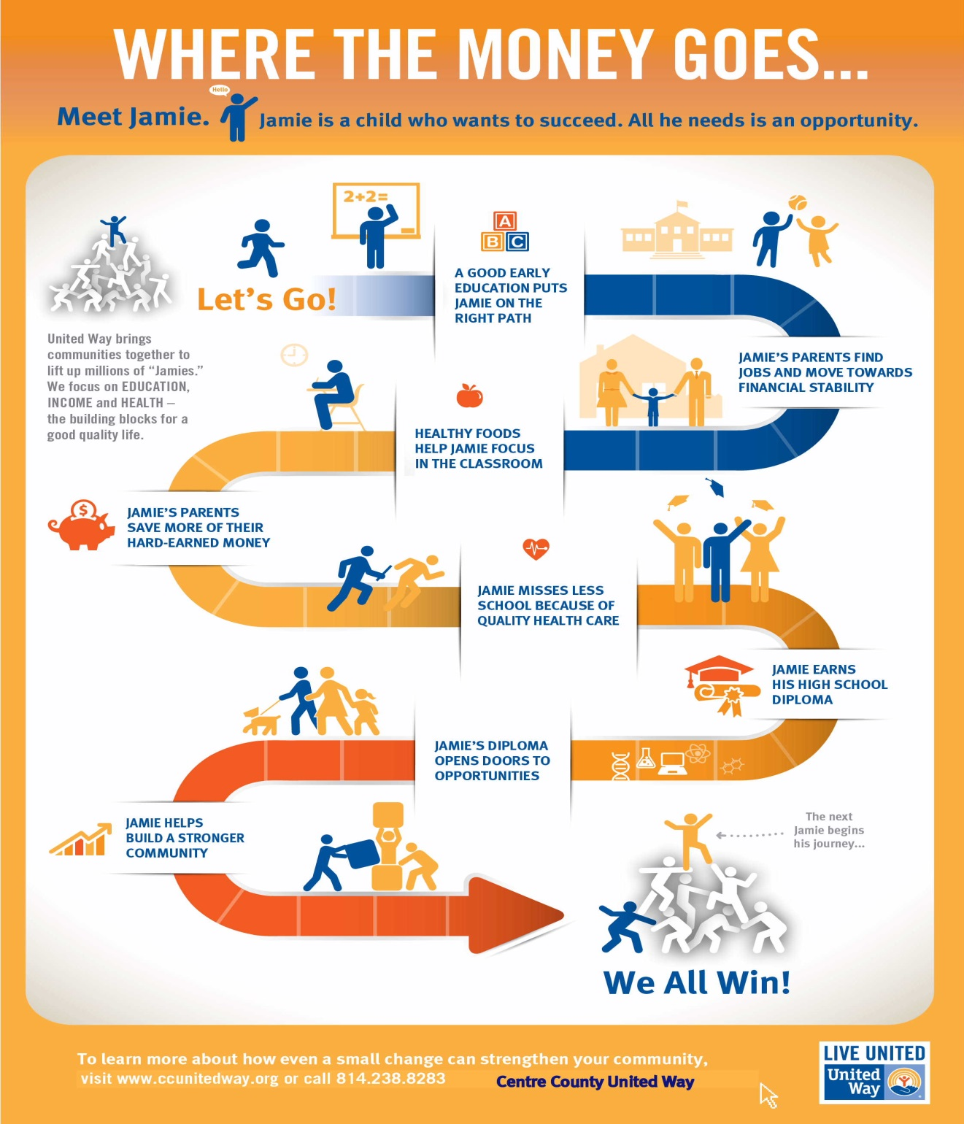
Centre County United Way
and our
Partner Agencies work together to ensure that every “Jamie”
has support
along the way.
It takes all of us to
LIVE UNITED!

Slide 17
THANK YOU!

